Slide 1


Next-Generation Sequencing (NGS)
Contact:
BioSci 4325a
613-533-2353
bit.ly/colautti
robert.colautti@queensu.ca
Rob Colautti
Biological Sciences

Slide 2
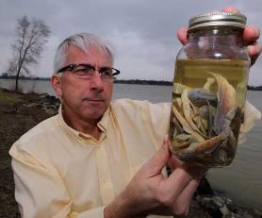
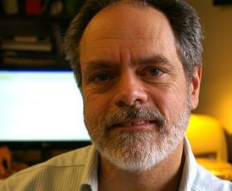

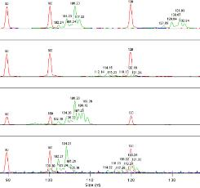

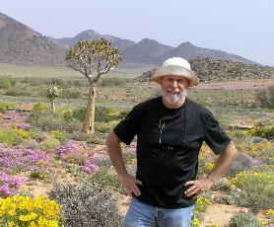
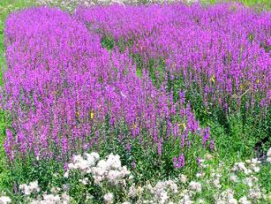
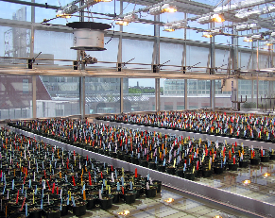
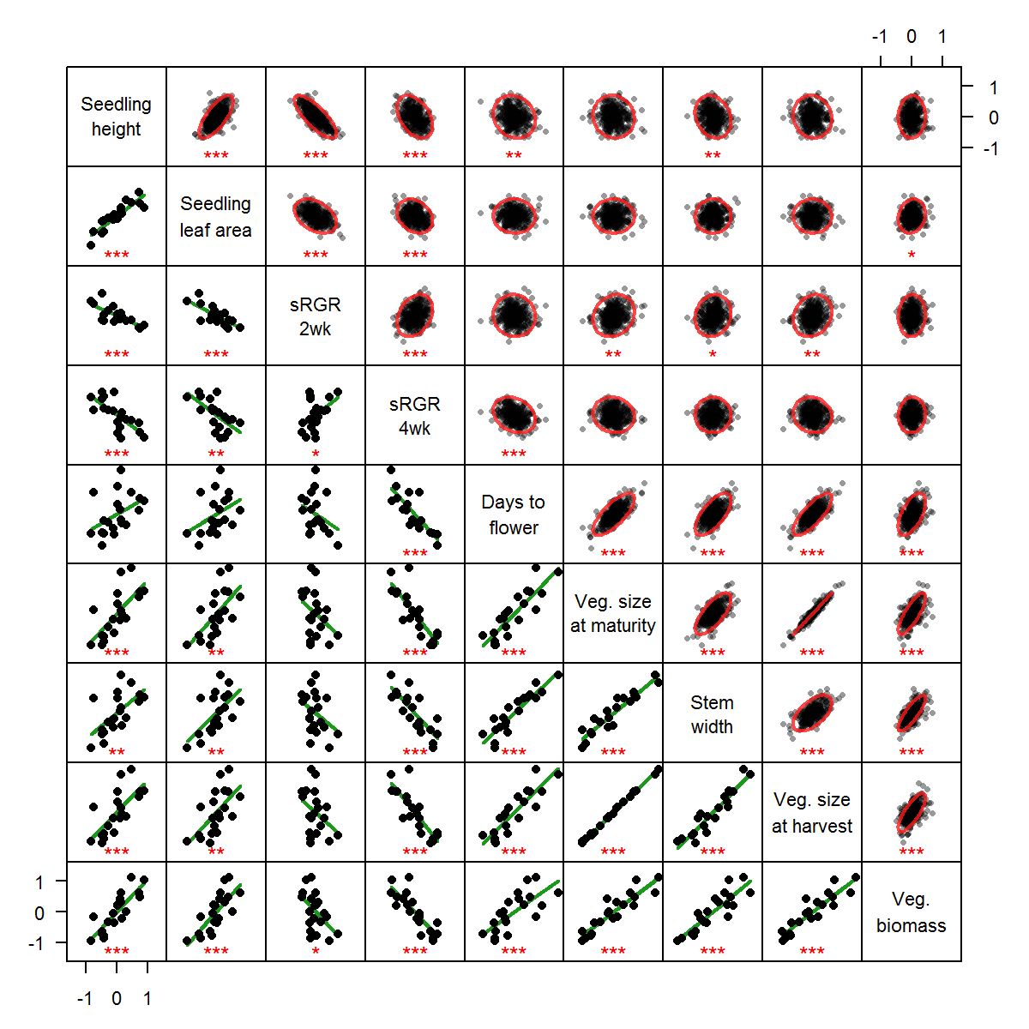
Research Background
University of Windsor & GLIER – Hs Bsc, MSc
Windsor, ON
Hugh MacIsaac
Dan Heath
University Toronto – PhD
Toronto, ON
Spencer Barrett

Slide 3
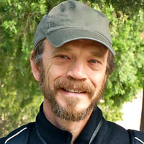
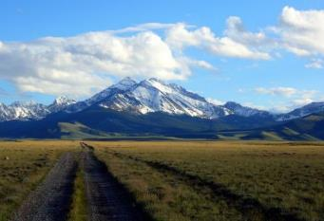
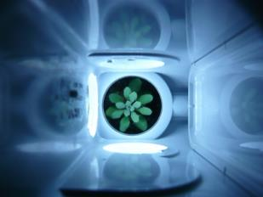
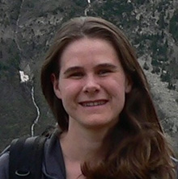
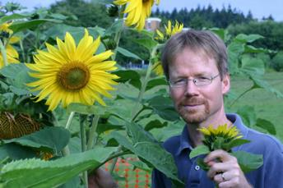
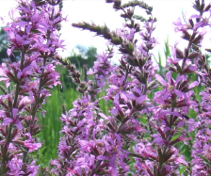
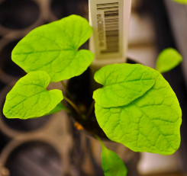
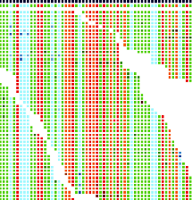
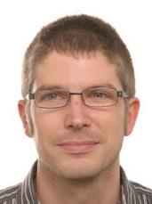
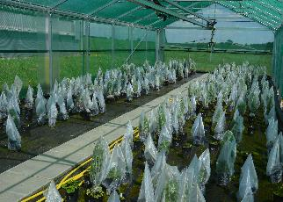

Research Background
Duke University – Postdoc
Durham, NC
Tom Mitchell-Olds
Jill Anderson
University of British Columbia – Postdoc
Vancouver, BC
Vancouver, BC
Loren Rieseberg
University of Tuebingen – Postdoc
Tuebingen, DE
Oliver Bossdorf

Slide 4
Overview
What is Next-Generation Sequencing (NGS)?
How does NGS work?
Why is NGS revolutionizing the biological sciences?

Slide 5
Introduction to NGS

Slide 6
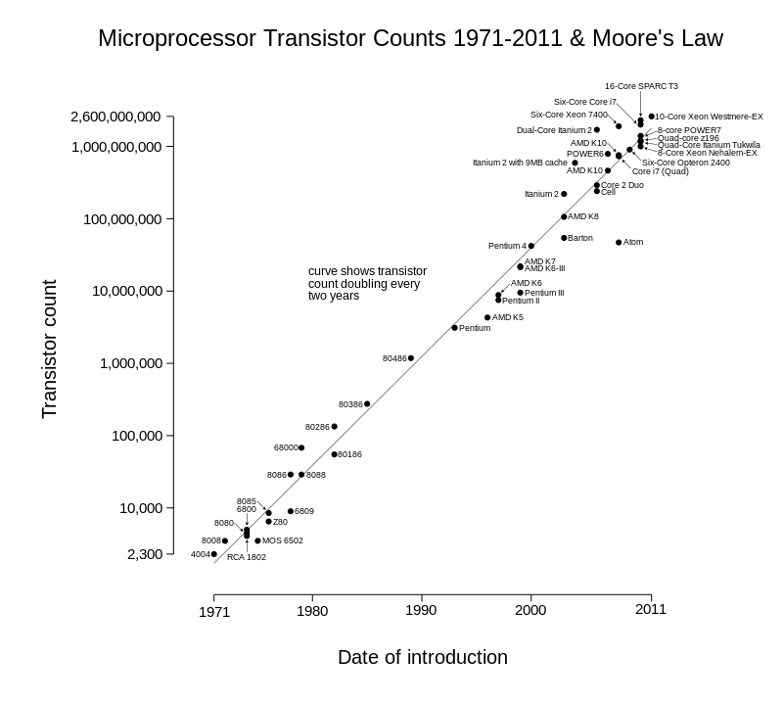
Moore's Law
"the number of transistors in a dense integrated circuit doubles approximately every two years"
-- Wikipedia (Feb 2, 2016)
Notes:
ask for definition

Slide 7
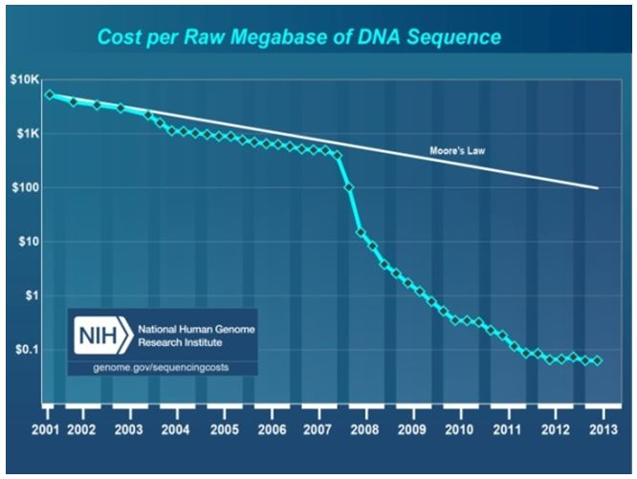
Moore's Law vs DNA Sequencing technology
Notes:
Anyone know what happened ~2008?

Slide 8
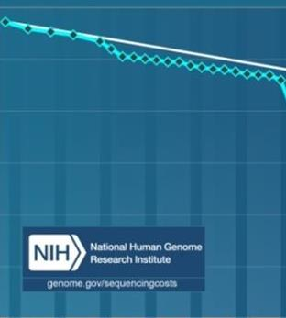
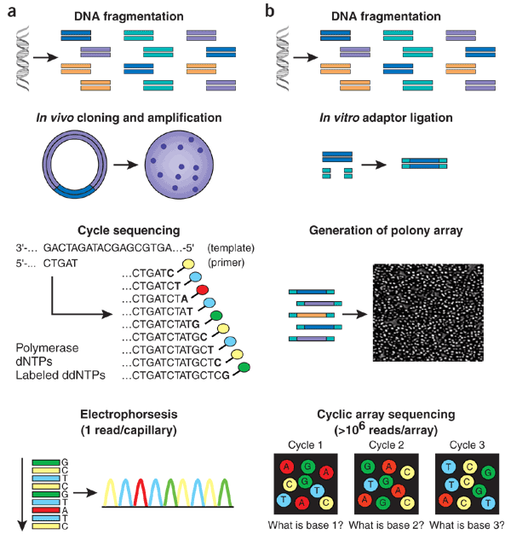
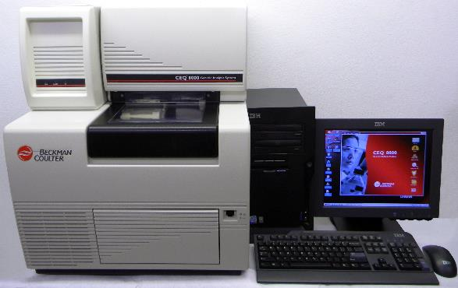
Sanger Sequencing
Dideoxy
chain
termination
sequencing
Beckman Coulter CEQ 8000
Notes:
CEQ ‘state of the art’ – banks machines for human genome

Slide 9
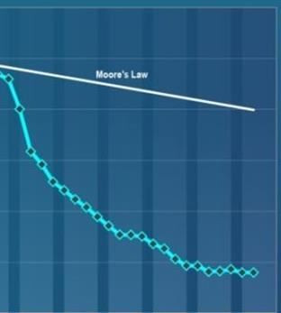
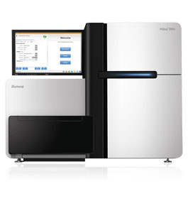
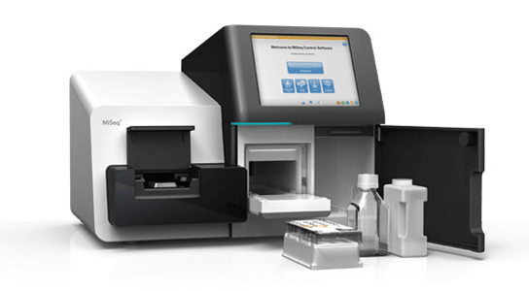
Next-generation sequencing (NGS)
Sequencing
by
synthesis
Illumina HiSeq & MiSeq

Slide 10
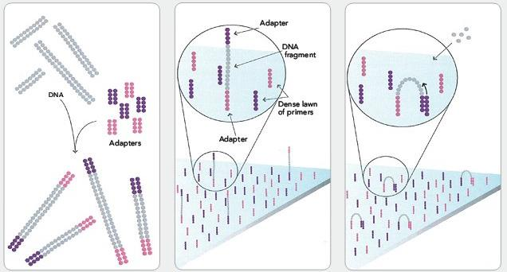
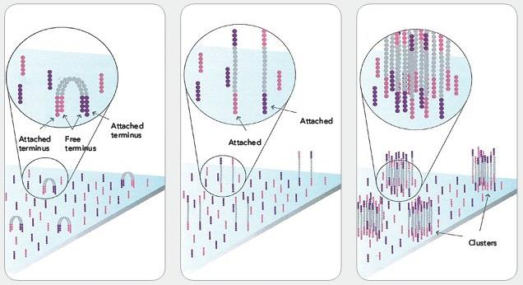
Illumina (Sequencing by synthesis)
1
2
3
Shear DNA into short fragments (~100-500bp) & ligate sequencing primers (adapters)
Attach DNA to surface
Bridge amplification
4. Fragments become double stranded
5. Denature the double stranded molecules
6. Cluster amplification
4
5
6
Illumina.com

Slide 11
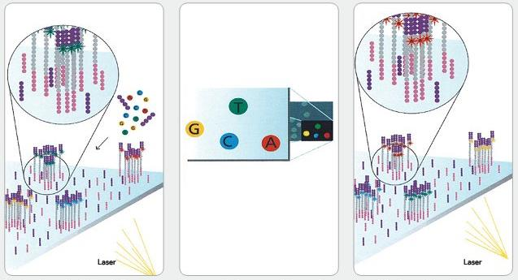
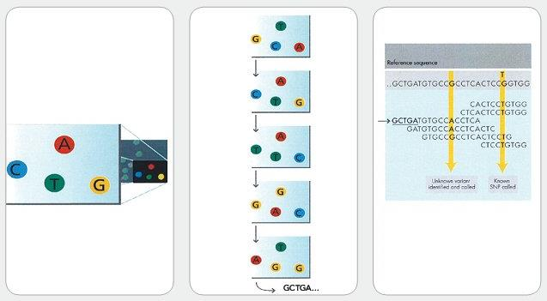
Illumina
7
8
9
7. Determine first base
8. Image first base
9. Determine second base
10. Image second base
11. Sequence reads over multiple cycles
12. Align data
HiSeq 3000/4000 up to 5 billion fragments/flow cell 2x 150bp fragment length
MiSeq up to 25 million 2x300bp
10
11
12
Illumina.com

Slide 12
Illumina
7
8
9
7. Add fluorescent-labelled nucleotides
8. Image first base
9. Flush flow cell and repeat
10. Image second base
11. Sequence reads over multiple cycles
12. Align data
10
11
12
Illumina.com

Slide 13
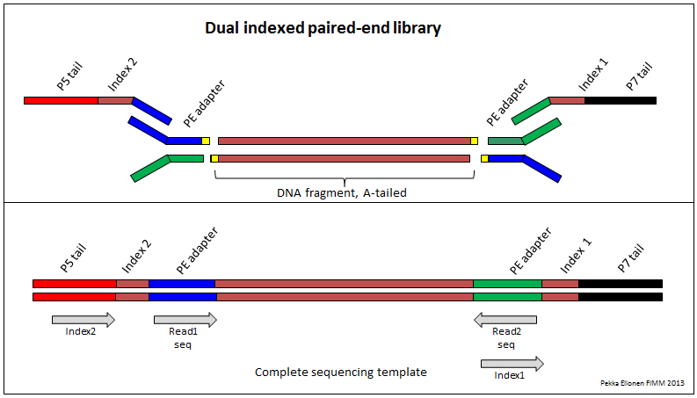
DNA construct

Slide 14
Advantages of Illumina
The industry standard
Versatile (see applications later)
Economic (price per Mb of data)
MiSeq – up to 2 x 300bp x 15M reads = 9 Gb
~$2,500 ($0.27)
HiSeq – up to 2 x 125bp x 200M reads = 50 Gb
~$3,000 ($0.06)
Compare Platforms:
http://www.molecularecologist.com/next-gen-fieldguide-2016/

Slide 15
Other NGS Platforms
PacBio – longest reads (>20kb)
genome assembly and full-length cDNA sequencing
DNA structural differences (e.g. inversions, transposon jumps)
BUT: see 10x genomics for Illumina
Ion Torrent – Fewer reads (1 Gb)
Lower up-front investment ($80k vs $150k+ for Illumina)
pre-existing variant panels (model organisms)
Amplicon sequencing (e.g. microbiome)
User-friendly, fast turnaround
Roche 454 – Obsolete; Lowest throughput (1 Mb)
cheaper long reads (up to 1 kb)
Microbiome studies

Slide 16
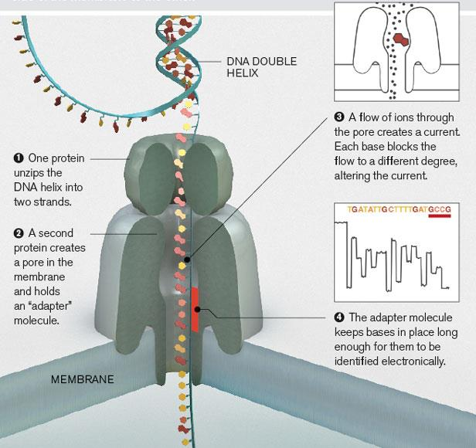
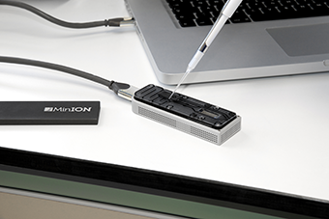
Experimental: MinION (Oxford Nanopore)
MIT Tech Review

Slide 17
Why is NGS revolutionizing Biology?
NGS-tools translate across disciplines. For example:
Metagenomics:
Soil, water, human gut microbiomes
Variant detection & GWAS
QTL mapping for agriculture, adaptive traits, environmental stressors, human health
Notes:
All organisms have RNA & DNA

Slide 18
Applications

Slide 19
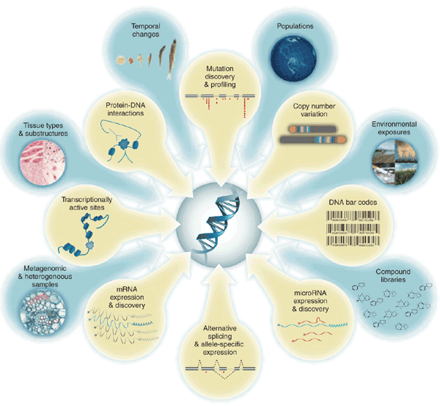
Applications
Kahvejian et al. (2008; Nature Biotech)

Slide 20
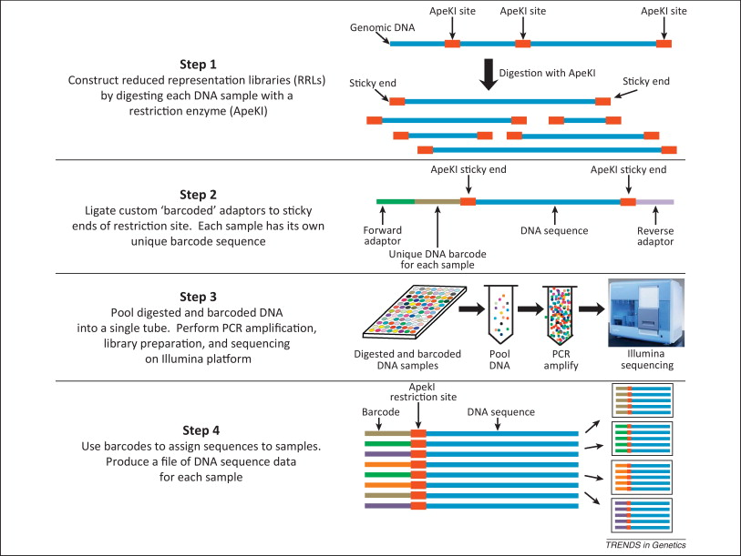
Genotype-by-sequencing (GBS)
Myles (2013; Trends Genetics)
Notes:
Applications (ask class)? GWAS,

Slide 21
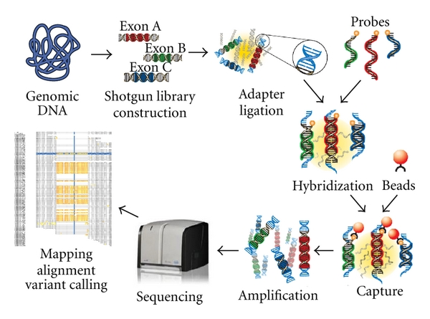
Target-capture sequencing

Slide 22
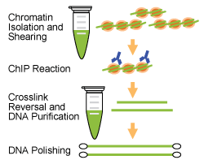
ChIP-seq (protein-targets)
Notes:
CHIP = Chromatin Immunoprecipitation

Slide 23
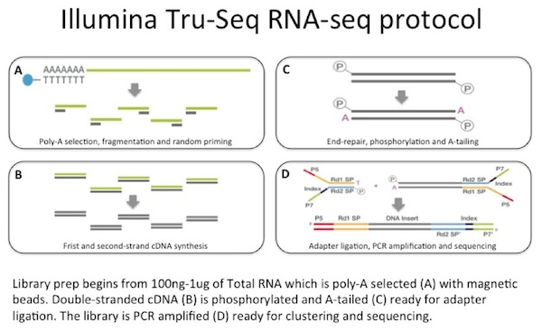
RNA-Seq
Illumina.com

Slide 24
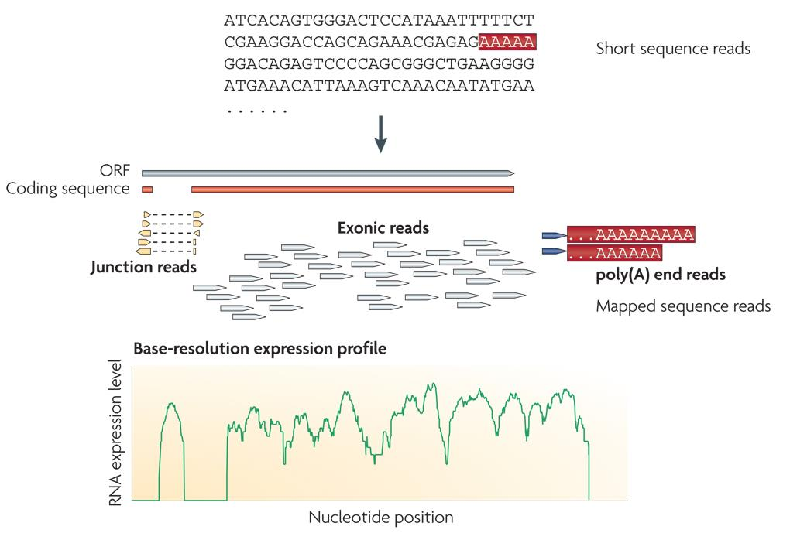
RNA-Seq expression profiles

Slide 25
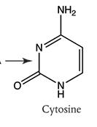
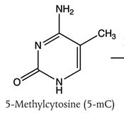
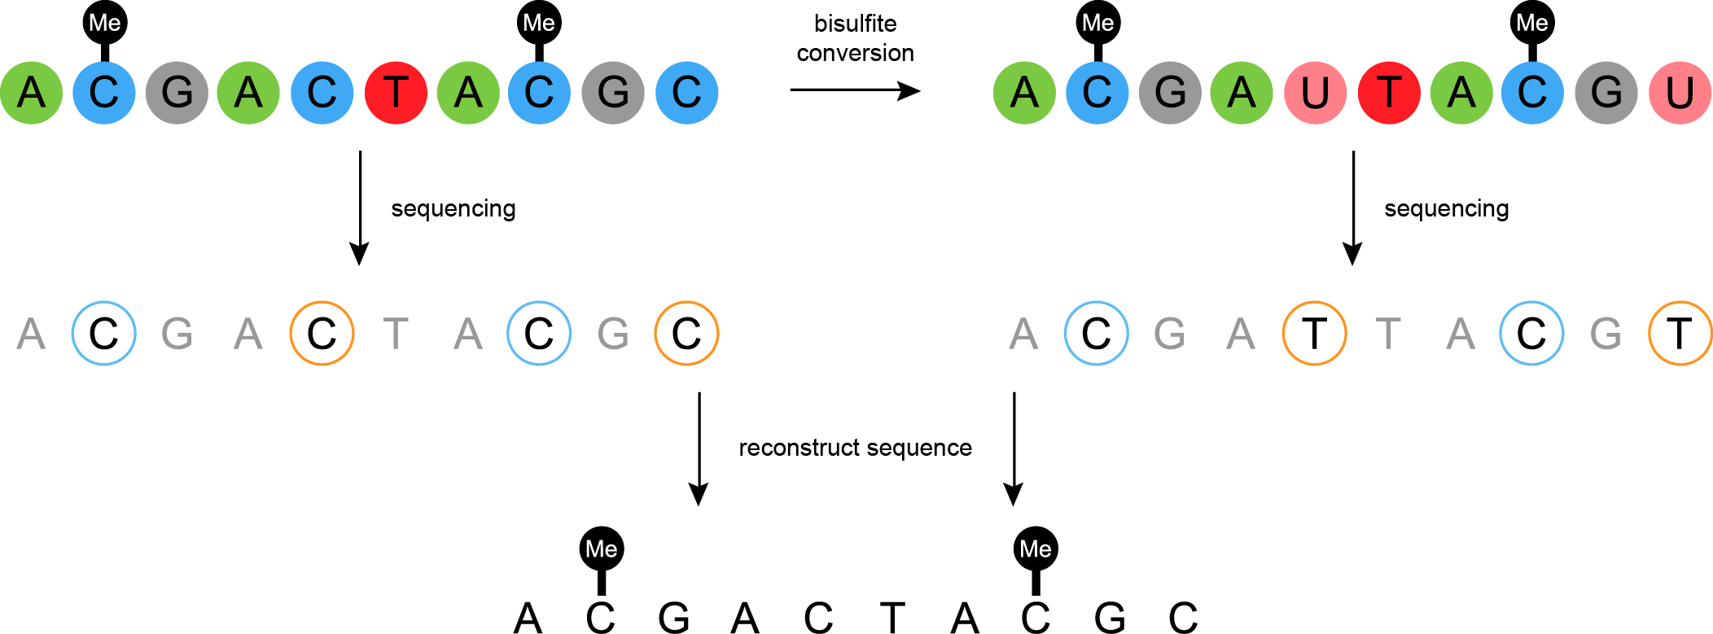
Bisulfite sequencing
\
atbio.com

Slide 26
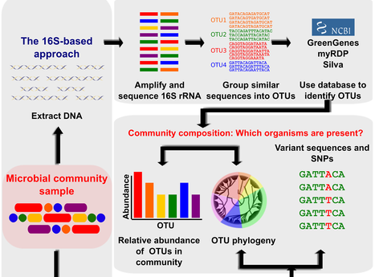
Metagenomics
OUT = Operational Taxonomic Unit

Slide 27
Whole-Genome Shotgun (WGS) sequencing
Extract
Fragment
Sequence
Align

Slide 28
Assembly with or without a reference
de novo assembly
'non-model' organisms
Alignment to reference
sometimes called 'resequencing'
common in 'model systems'
e.g. human, mouse, Drosophila, C. elegans, Arabidopsis
Reference genome
Consensus sequence
Contiguous consensus sequences
(contigs)

Slide 29
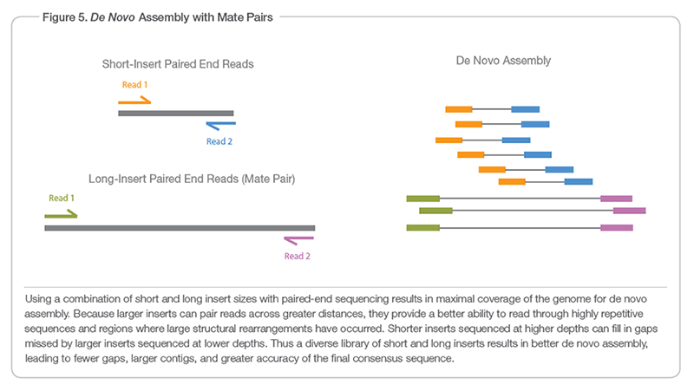
De novo assembly
IMPORTANT: Paired End vs Mate-Pair
Illumina.com

Slide 30
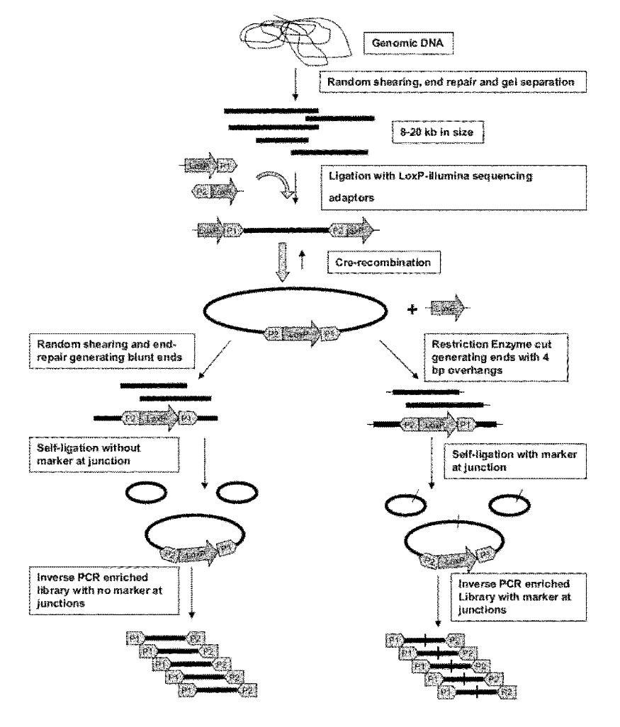
Mate pair library
http://www.google.com/patents/US20120329678

Slide 31
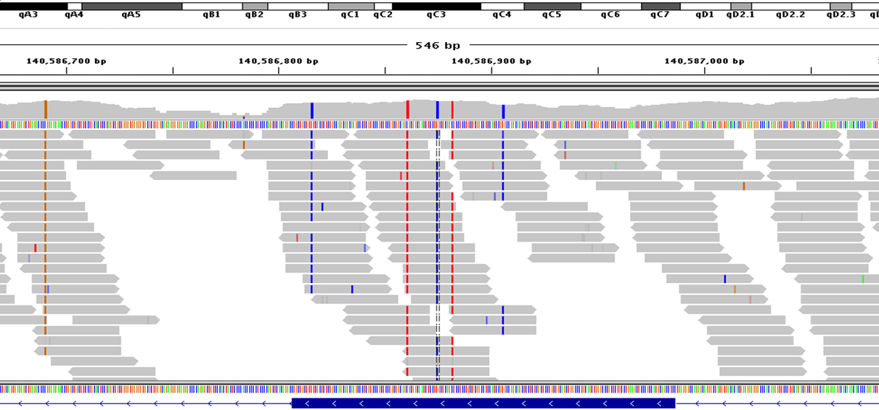
Coverage
LOW
HIGH
= average # reads at any given location (base pair)
A 'random' sampling process
(Higher is better)

Slide 32
de novo assembly programs*
ABySS
ALLPATHS-LG
CORTEX
CLC Genomics Workbench
DISCOVAR de novo
Geneious
IDBA
MaSuRCA
MIRA
PLATANUS
RAY
SOAP de novo
*Large genome assemblers (>0.5Gb)
Gold = commercial/restricted license

Slide 33
Challenges

Slide 34
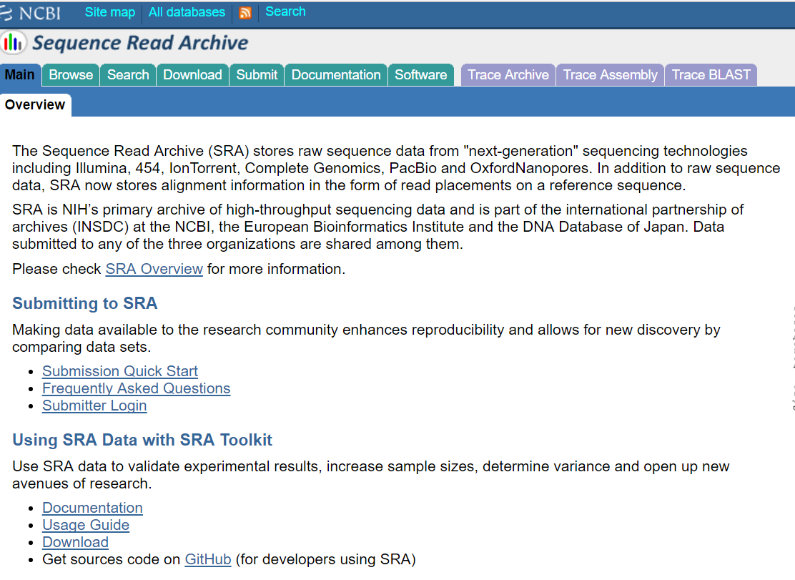
‘Big Data’ Computation
https://trace.ncbi.nlm.nih.gov/Traces/sra/

Slide 35
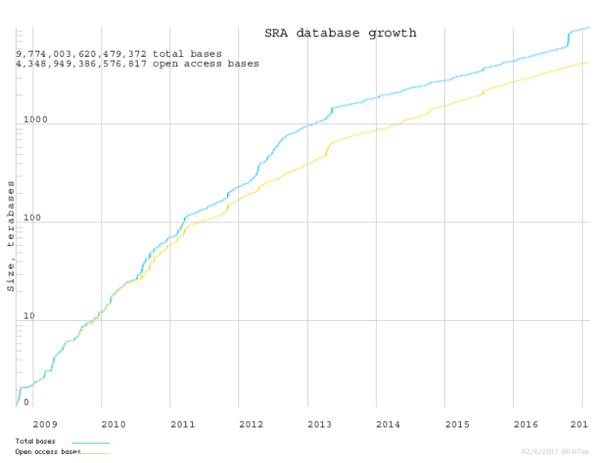
‘Big Data’ (~10 Petabytes)

Slide 36
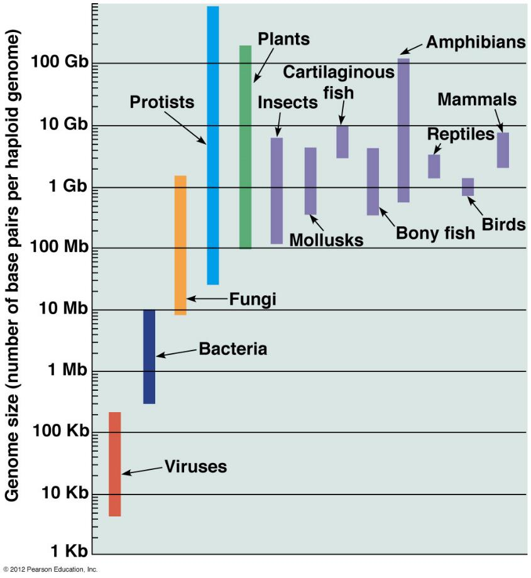
Large genomes
Human
(~3.2Gb)

Slide 37
Assembly challenges
Large repeats – creates gaps
Errors – cannot be assembled
Low coverage – creates gaps
Unequal coverage – confuses error correction

Slide 38
NGS and Ecological Genomics
in the Colautti Lab

Slide 39
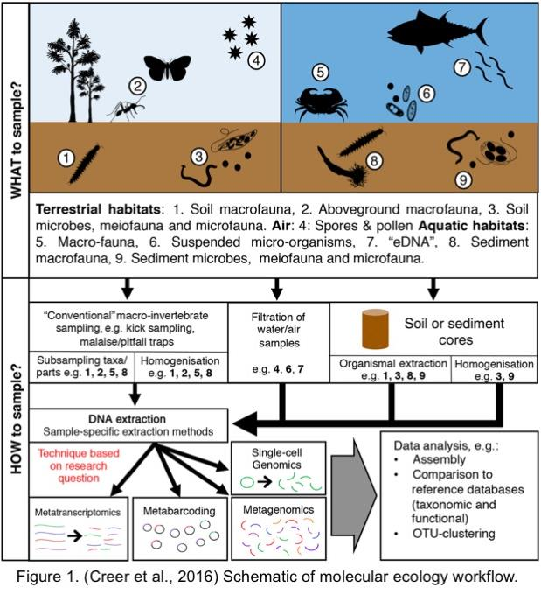
Ecological Genomics

Slide 40
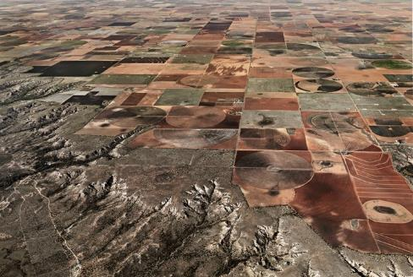





Ecology and Evolution in the Anthropocene
Magellan I Sverige
James Hoznik
Environment --> Natural Selection --> Genome Evolution
Photos by Ed Burtynsky (mostly)

Slide 41


Ecological genomics of invasive species
USFWS
Dreissena polymorpha
gbif.org

Slide 42












Invasions: grand, unplanned ecological experiments

Slide 43







eDNA and DNA barcodes for environmental monitoring
Barcode of Life Project
www.boldsystems.org
https://www.youtube.com/watch?v=ZImiXgU6bCk

Slide 44



Tick microbiome analysis
Lyme disease in Canada (cbc.ca)
Ixodes scapularis (black-legged tick)

Slide 45
NGS @Queen’s
Biology Department has the only Illumina sequencer on campus (MiSeq)
Other machines (IonTorrent, microarrays) spread across campus
Queen’s has no university-wide genomics core facility – very unusual for a research-intensive university

Slide 46
NGS @ Queen’s: Typical WGS sequencing workflow
Library Prep
Extract & Purify DNA
Fragment and size-select
Sequencing
Generate FASTQ file – includes sequence data (short-reads) and quality score
Assembly
Assemble short-reads into contigs and scaffolds
Ligate sequencing primers
Analysis
e.g. genome annotation; comparative genomics; structural variant detection; taxonomy ID (metagenomics); align short reads for variant detection (e.g. for GWAS)

Slide 47


QC @ Queen’s
Agilent Bioanalyzer

Slide 48
MiSeq @ Queen’s

Slide 49





de novo sequencing Application
Ecological genomics
of
Alliaria petiolata
Loren Rieseberg
Oliver Bossdorf

Slide 50
Ecological genomics of Alliaria petiolata

Slide 51


Why Alliaria petiolata?
Problematic invasive species in North America
Easy to identify
Simple lifetime fitness estimate
Brassicaceae, self-pollinated
Ecologically important chemistry
(Enemy release; allelopathy/soil biota)
Year 1
Year 2

Slide 52

Alliaria petiolata ecology: plant-microbe interactions

Slide 53


Alliaria petiolata ecology: plant-microbe interactions
Mycorrhizal fungus
Root

Slide 54


Alliaria petiolata ecology: plant-microbe interactions

Slide 55
Global garlic mustard field survey
International collaboration
164 participants from 16 countries
Field surveys
45,000 field measurements
Plant performance traits
Herbivory & fungal damage
Genetic resource
Seeds from >5,000 plants
395 locations across Europe and North Am.

Slide 56
Population genomics: Some major questions
How many introductions to North America, from which parts of Europe, and how has it been moved around?
Which genes affect survival and reproduction in response to:
cold vs warm climates
wet vs dry conditions
native vs introduced range
herbivores and pathogens
competition with other plants
Does selection act mainly on a few loci with large effects on phenotype, or many loci with smaller effects?
How important is standing genetic variation vs new mutations?
How important are SNPs vs genome rearrangements?

Slide 57

Alliaria petiolata draft chloroplast genome 153,190 bp

Slide 58


de novo assembly (Sanger)

Slide 59

de novo assembly (NGS)
de Bruijn graph method
based on k-mers

Slide 60

de novo assembly (NGS)
de Bruijn graph
‘bubbles’ in the assembly

Slide 61
De novo assembly
In practice
$ tar -zxvf CAC_files.tar.gz /home/hpc####

